Slide 1
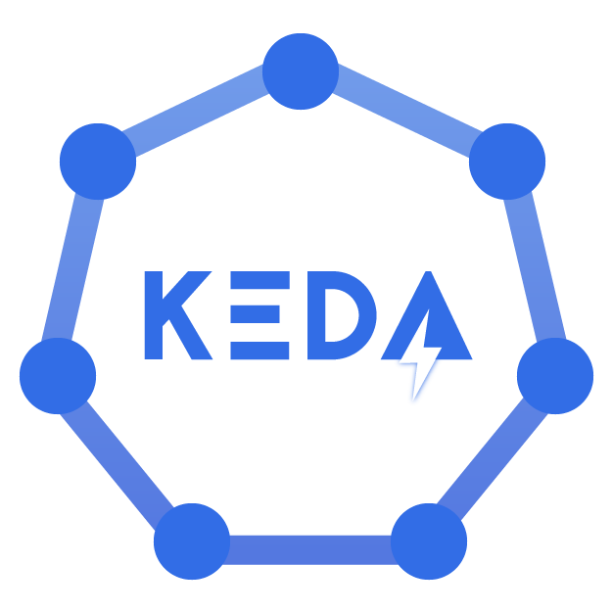
Scaling Applications in Kubernetes using KEDA

Slide 2
Agenda
Why scaling in Kubernetes?
Scaling types
Cluster Autoscaler
Vertical Pod Autoscaling (VPA)
Horizontal Pod Autoscaling (HPA)
Increasing Scaling Demands and External Metrics API Kubernetes Limitation
Kubernetes Event-driven Autoscaler (KEDA)
KEDA Custom Resources (CRD)
Demo
Best practices

Slide 3
Why scaling in Kubernetes?
Kubernetes Scaling refers to the dynamic adjustment of resources within a Kubernetes cluster to accommodate varying workloads and traffic demands.
Why scaling matters?
Traffic Surge: During the sale, tons of people visit your website at the same time.
Resource Demand: All these visitors need a lot of computer power to use your website. Without enough power, your website might slow down or even crash.
Reliability: Your website must work well, or customers will get frustrated and leave. You need it to be fast and available all the time.
How Kubernetes Scaling Helps?
More Servers: Kubernetes can quickly add more servers when needed. It's like hiring more workers when a store gets busy.
Even Workload: Kubernetes spreads out the work, so no server gets overwhelmed. It's like having many cashiers during a big sale.
Scaling: Kubernetes can do this automatically. It adds more servers when things get busy and removes them when it's quieter.
Efficient Use of Resources: It also makes sure each server uses just the right amount of computer power, so you don't waste money.
Benefits of Scaling in Kubernetes:
Always Open: With Kubernetes, your website stays open and works well even when lots of people are shopping.
Saves Money: You only pay for extra servers when you need them. It's like paying extra workers only when there's a big sale.
Happy Customers: Customers can shop without problems, which is super important during a big sale.

Slide 4
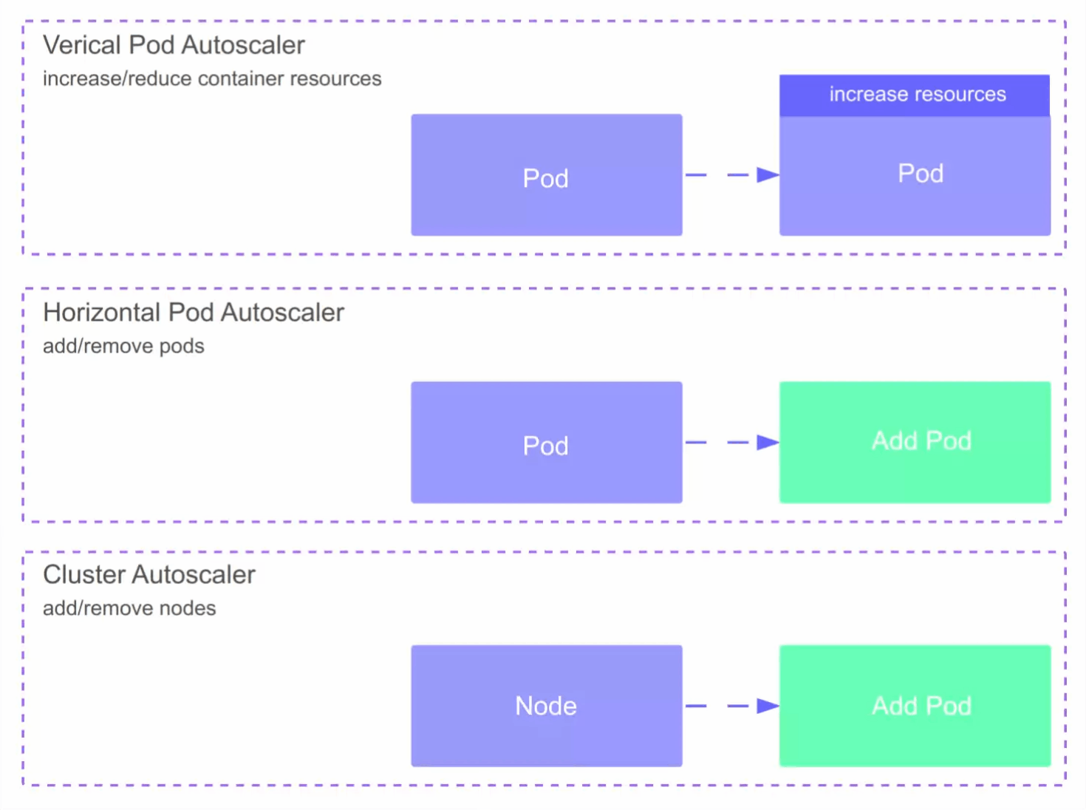
Scaling types
Manual Scaling:
Imperative Scaling
Declarative Scaling
Imperative: kubectl scale my-application --replicas=4 Declarative: kubectl apply -f my-application-deployment.yaml
Autoscaling
Horizontal Pod Autoscaling
Vertical Pod Autoscaling
Cluster Autoscaling

Slide 5
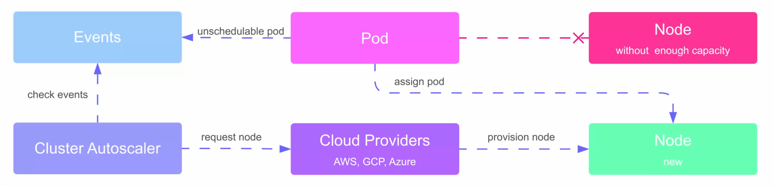
Cluster Autoscaler
The cluster autoscaler automatically adds or removes nodes in a cluster based on all pods’ requested resources. It seeks unschedulable pods and tries to consolidate pods that are currently deployed on only a few nodes. It loops through these two tasks constantly.

Slide 6
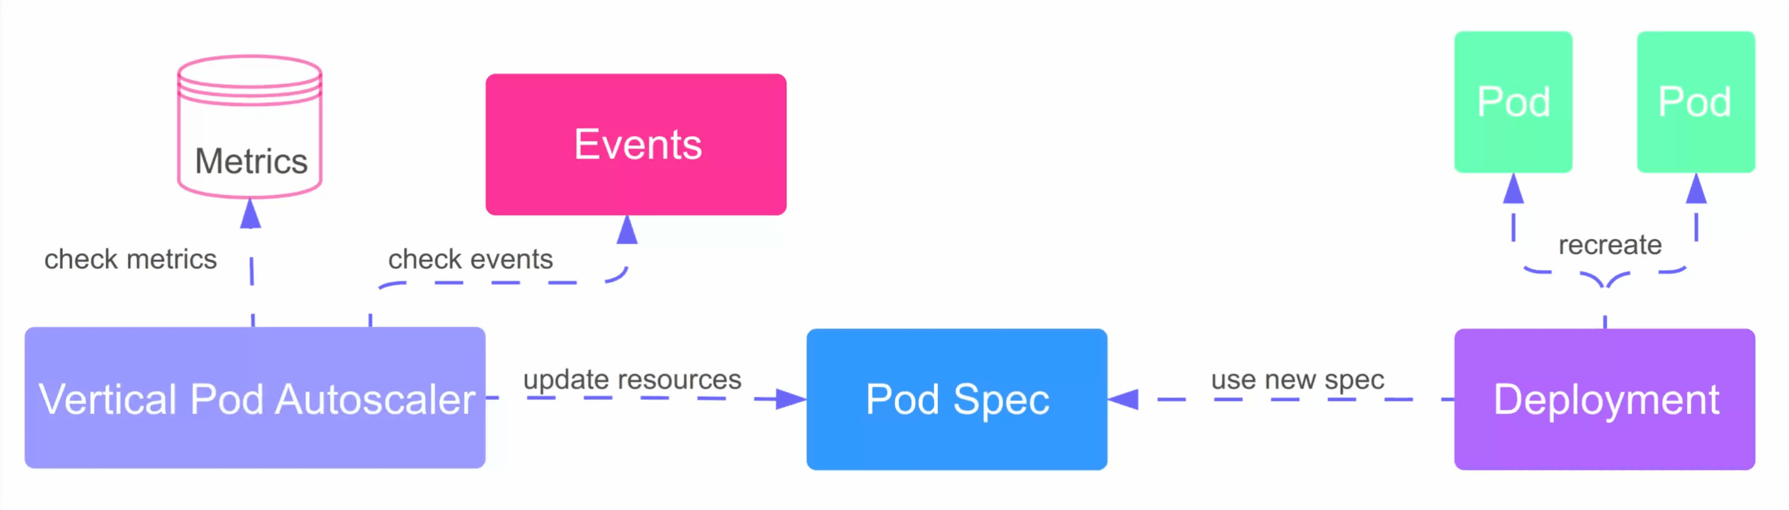
Vertical Pod Autoscaling (VPA)
The Vertical Pod Autoscaler automatically adds or adjusts CPU and memory reservations for your pods.

Slide 7
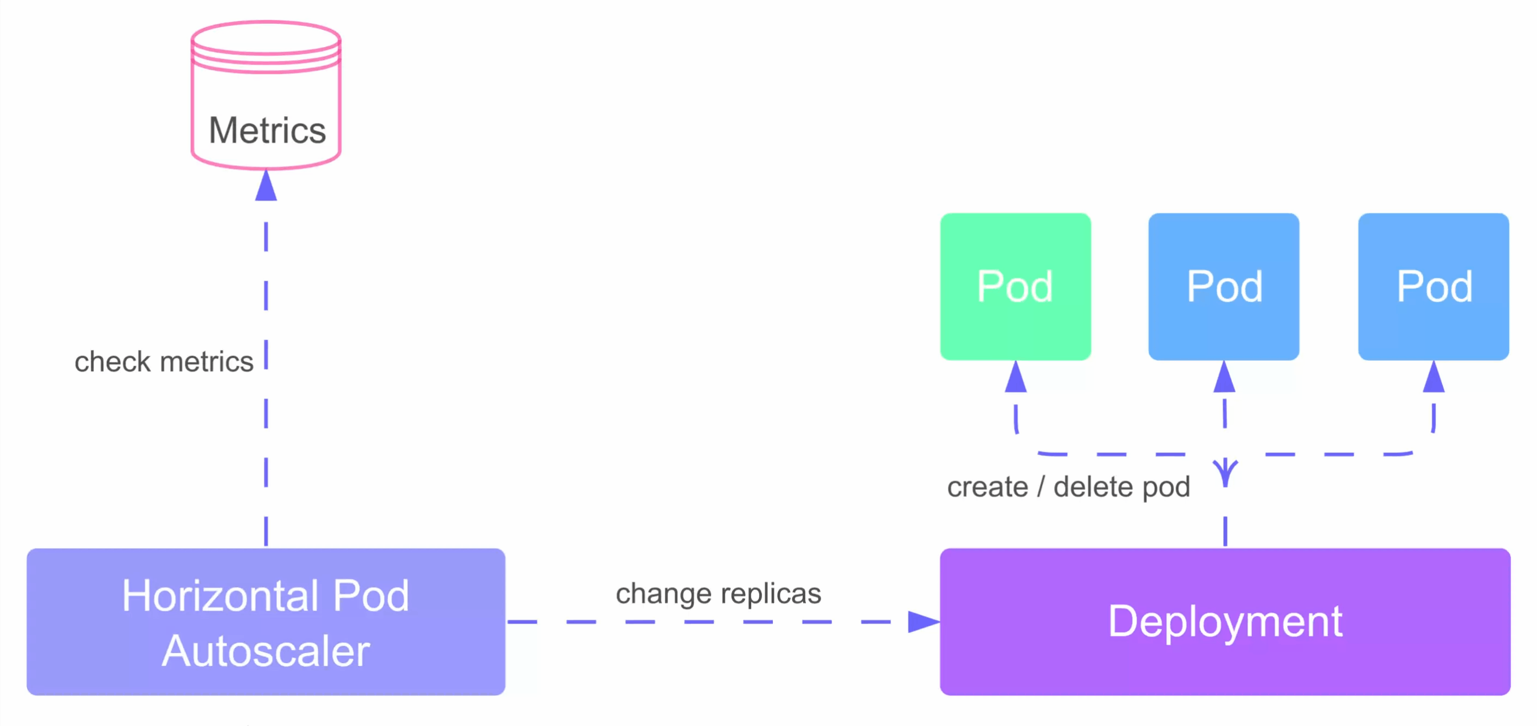
Horizontal Pod Autoscaling (HPA)
Horizontal Pod Autoscaler (HPA) automatically adds or removes pod replicas

Slide 8
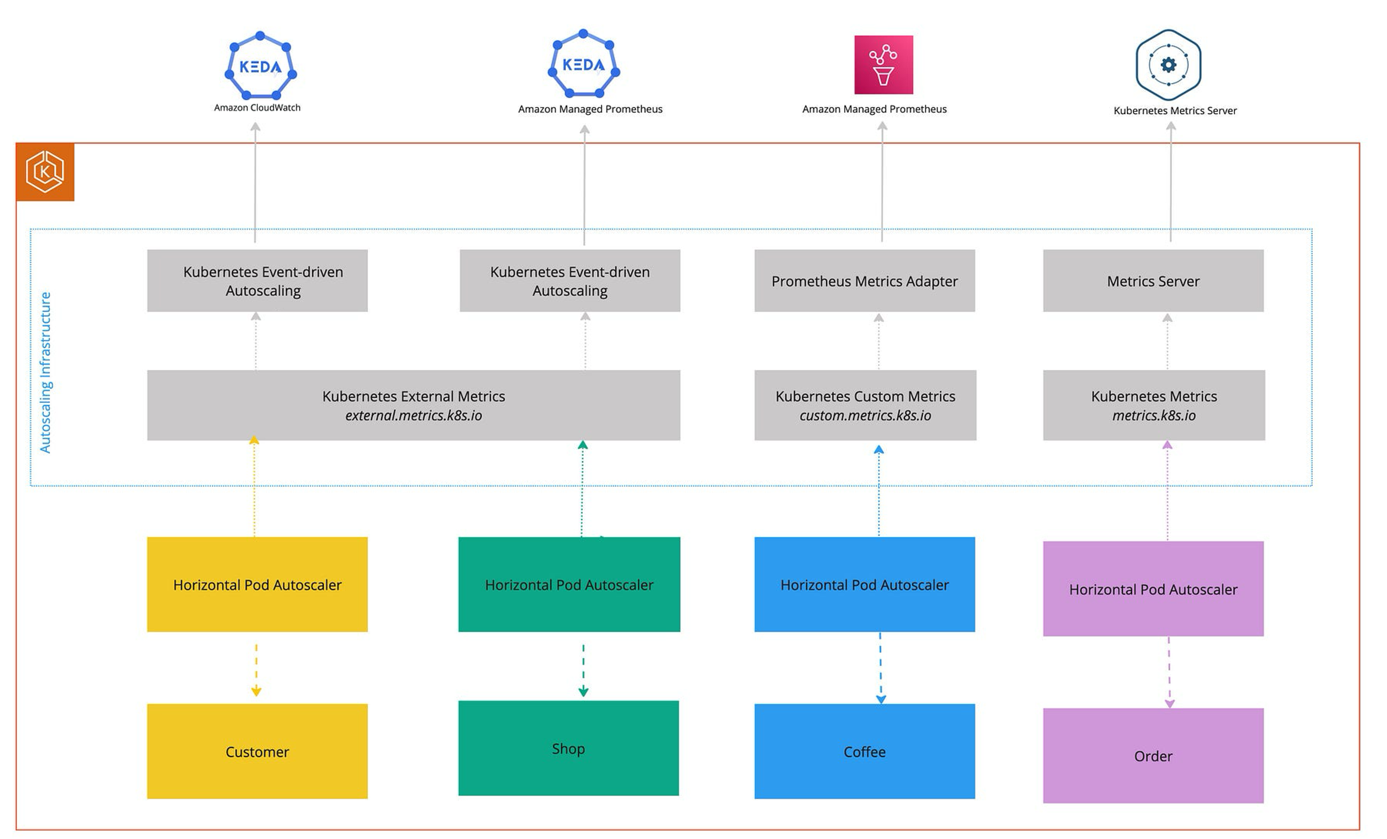
Increasing Scaling Demands and External Metrics API Kubernetes Limitation

Slide 9
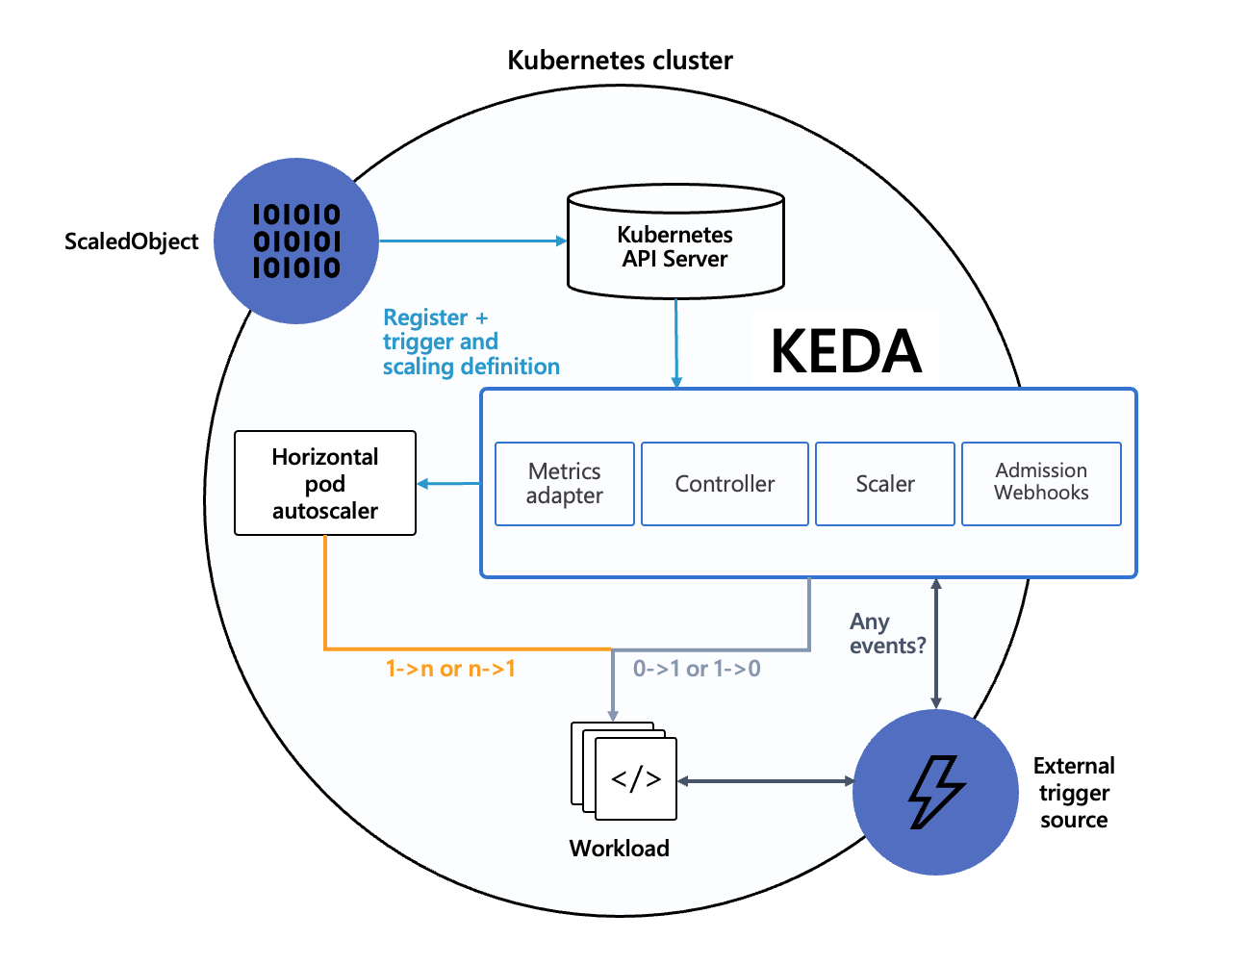
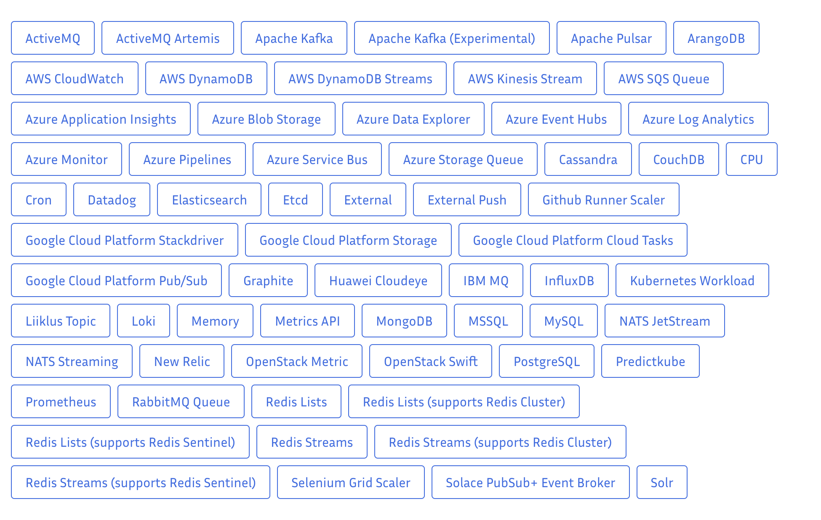
Kubernetes Event-driven Autoscaler (KEDA)

Slide 10
KEDA Custom Resources (CRD)
scaledobjects.keda.sh
scaledjobs.keda.sh
triggerauthentications.keda.sh
clustertriggerauthentications.keda.sh
represents the mapping between event sources and objects, and specifies the scaling rules for a Deployment, StatefulSet, Jobs or any Custom Resource in a K8s cluster
TriggerAuthentication allows you to describe authentication parameters separate from the ScaledObject and the deployment containers. It also enables more advanced methods of authentication like “pod identity”, authentication re-use or allowing IT to configure the authentication.
For cases where you want to share a single set of credentials between scalers in many namespaces, you can instead create a ClusterTriggerAuthentication. As a global object, this can be used from any namespace.
Similarly, this one is used to specify scaling rules for Kubernetes Jobs.

Slide 11
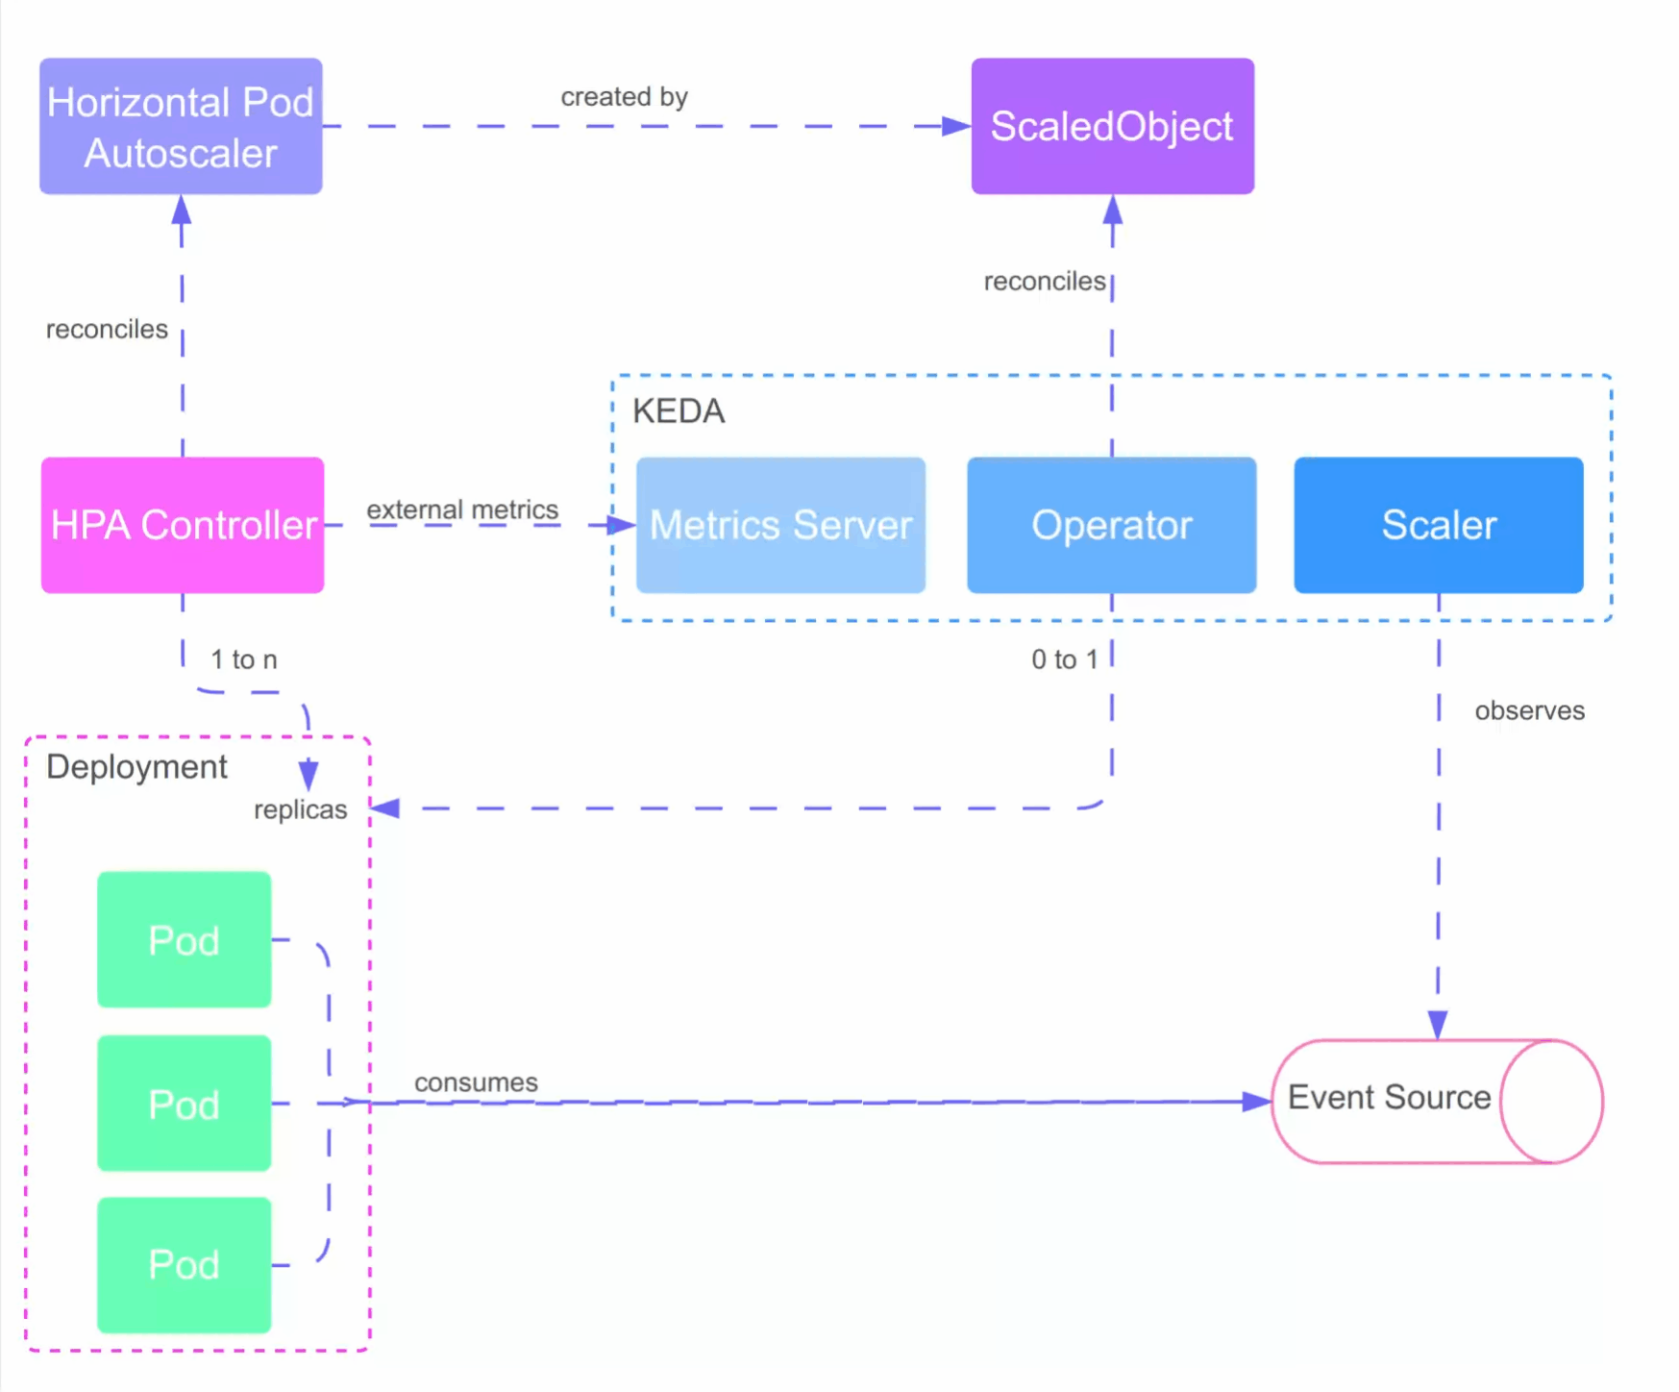
Demo

Slide 12
Best practices
Monitor and Analyze: Regularly monitor your application’s resource utilization, performance metrics, and user traffic patterns. This data will help you make informed decisions about scaling thresholds and resource allocation.
Set Appropriate Scaling Metrics: Choose the right metrics (CPU, memory, or custom) for scaling based on your application’s characteristics and requirements. Experiment and fine-tune to find the optimal balance between responsiveness and resource efficiency.
Test and Validate: Before deploying auto-scaling policies in production, thoroughly test them in staging or development environments. Simulate different traffic scenarios to ensure your scaling configurations behave as expected.
Start Conservatively: Begin with conservative scaling settings and gradually increase thresholds as you gain confidence in your application’s performance and scalability. Avoid aggressive scaling policies that may lead to unnecessary resource consumption or instability.

